Slide 1
Object Oriented Programming—C++ Lecture3 Memory Concept and Streams
Qijun Zhao
College of Computer Science
Sichuan University
Spring 2025

Slide 2
Table of Contents
Heap and Stack
sizeof Operator
Streams

Slide 3
Heap and Stack

Slide 4
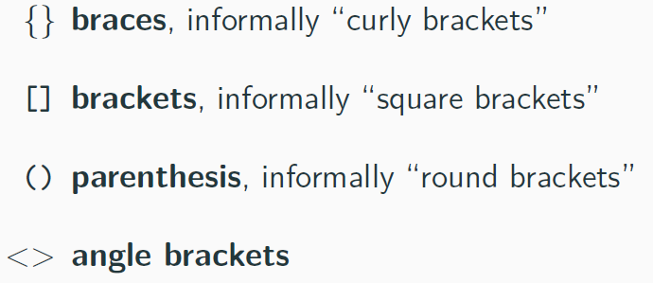
Parenthesis and Brackets

Slide 5
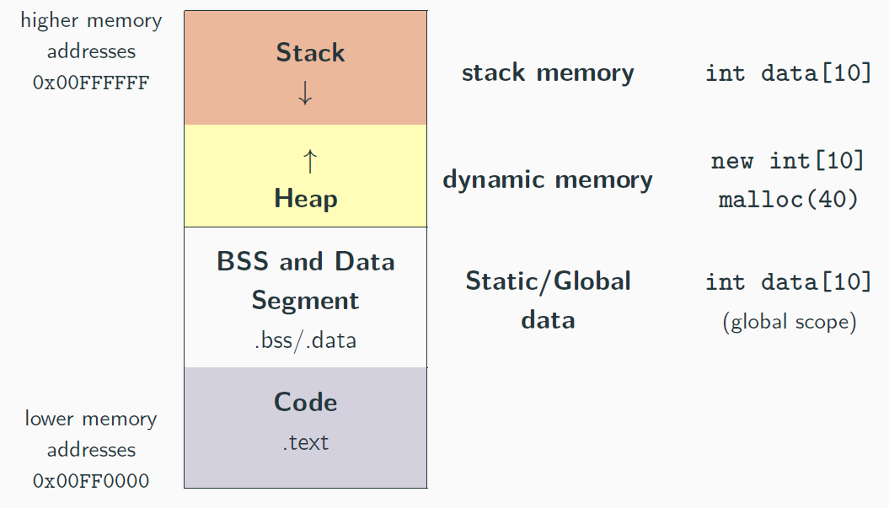
Process Address Space

Slide 6
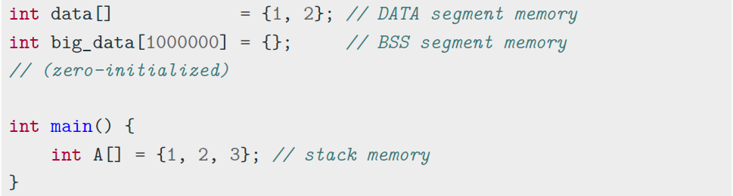
Data and BSS Segment
Data/BSS (Block Started by Symbol) segments are larger than stack memory (max ≈ 1GB in general) but slower
Notes:
http://www.360doc.com/content/23/0918/23/65649819_1097016226.shtml

Slide 7
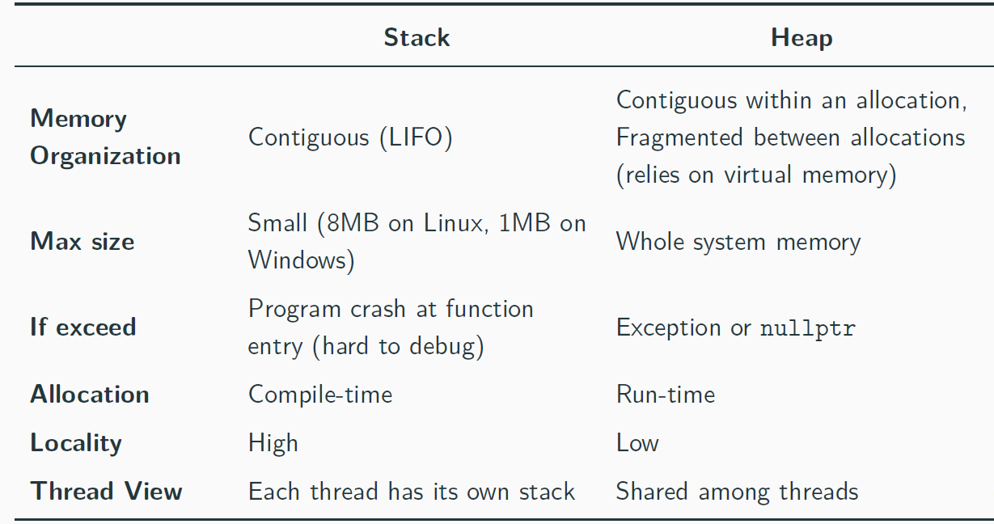
Stack and Heap Memory Overview

Slide 8
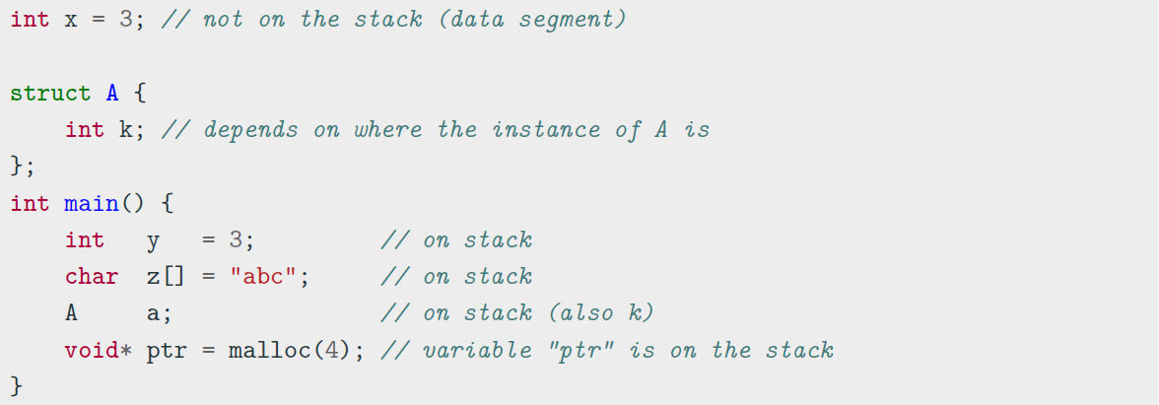
Stack Memory
A local variable is either in the stack memory or CPU registers
The organization of the stack memory enables much higher performance. On the other hand, this memory space is limited!!

Slide 9
Stack Memory Data
Types of data stored in the stack:
Local variables Variable in a local scope
Function arguments Data passed from caller to a function
Return addresses Data passed from a function to a caller
Compiler temporaries Compiler specific instructions
Interrupt contexts

Slide 10
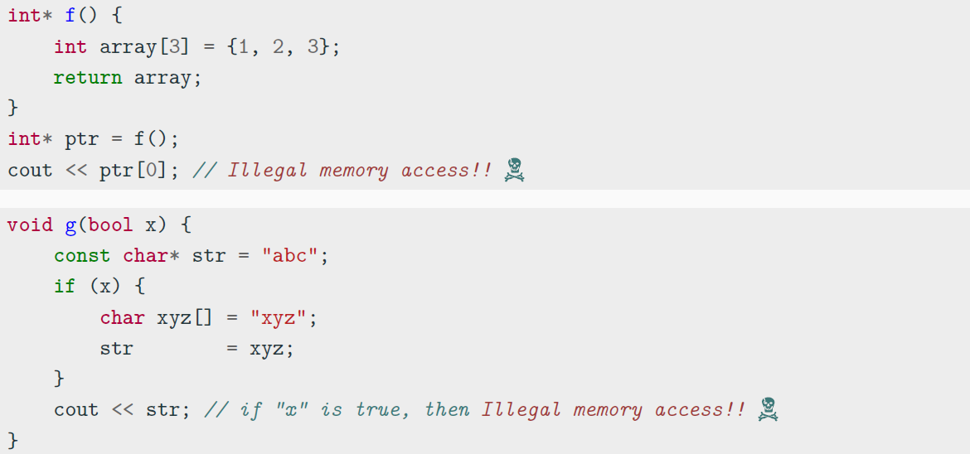
Stack Memory
Every object which resides in the stack is not valid outside his scope!!

Slide 11
Heap Memory - new, delete Keywords
new, delete
new/new[] and delete/delete[] are C++ keywords that perform dynamic
memory allocation/deallocation, and object construction/destruction at runtime
malloc
and
free
are C functions and they only allocate and free memory blocks
(expressed in bytes)

Slide 12
new, delete Advantages
Language keywords, not functions ➡ safer
Return type: new returns exact data type, while
malloc()
returns
void*
Failure: new throws an exception, while returns a
pointer ➡ it
malloc()
NULL
cannot be ignored, zero-size allocations do not need special code
Allocation size: The number of bytes is calculated by the compiler with the new
keyword, while the user must take care of manually calculating the size for
malloc()
Initialization: new can be used to initialize besides allocate
Polymorphism: objects with virtual functions must be allocated with new to initialize the virtual table pointer

Slide 13
Dynamic Memory Allocation
Allocate a single element
int* value = (int*) malloc(sizeof(int)); // C
int* value = new int; // C++
Allocate N elements
int* array = (int*) malloc(N * sizeof(int)); // C
int* array = new int[N]; // C++
Allocate N structures
MyStruct* array = (MyStruct*) malloc(N * sizeof(MyStruct)); // C
MyStruct* array = new MyStruct[N]; // C++
Allocate and zero-initialize N elements
int* array = (int*) calloc(N, sizeof(int)); // C
int* array = new int[N](); // C++

Slide 14
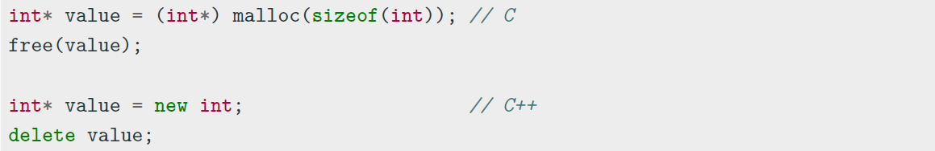
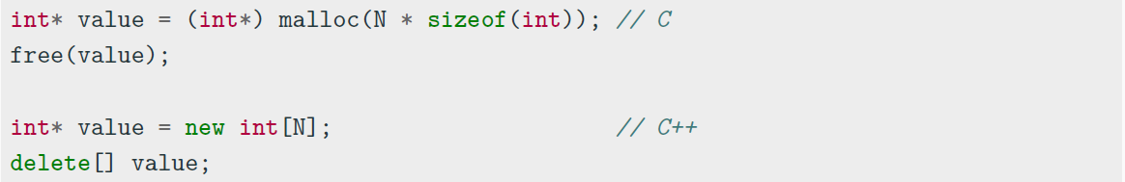
Dynamic Memory Deallocation
Deallocate a single element
Deallocate N elements

Slide 15
Allocation/Deallocation Properties
Fundamental rules:
Each object allocated with
Each object allocated with
Each object allocated with
malloc()
must be deallocated with
free()
new
must be deallocated with
delete
new[]
must be deallocated with
delete[]
malloc() , new ,
new[]
never produce
NULL
pointer in the success case,
except for zero-size allocations (implementation-defined)
free() , delete , and applied to NULL / nullptr pointers do not
delete[]
produce errors
Mixing new , new[] ,
malloc
with something different from their counterparts leads
to undefined behavior

Slide 16
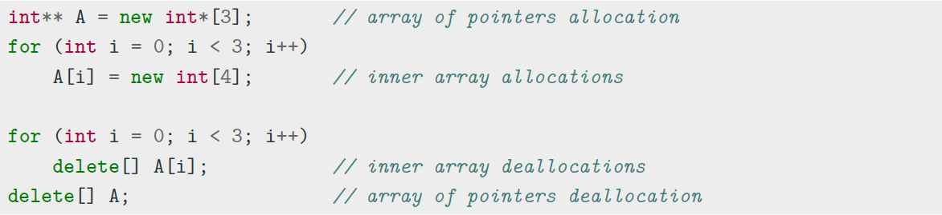
2D Memory Allocation
Easy on the stack - dimensions known at compile-time:
int A[3][4]; // C/C++ uses row-major order: move on row elements, then columns
Dynamic Memory 2D allocation/deallocation - dimensions known at run-time:

Slide 17
2D Memory Allocation ⋆
Dynamic memory 2D allocation/deallocation C++11:
auto A = new int[3][4]; // allocate 3 objects of type int[4]
int n = 3; // dynamic value
auto B = new int[n][4]; // ok
// auto C = new int[n][n]; // compile error
delete[] A; // same for B, C

Slide 18
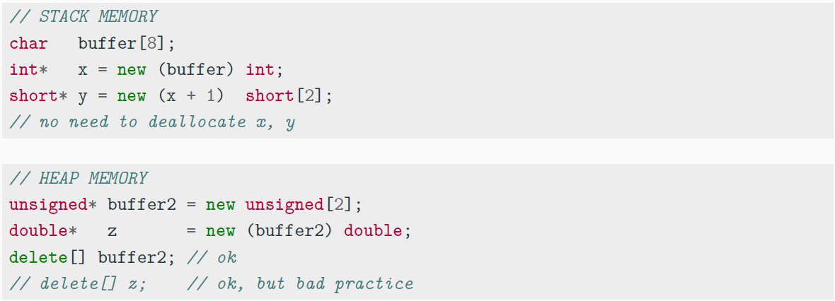
Non-Allocating Placement ⋆
A non-allocating placement
(ptr) type
allows to explicitly specify the memory
location (previously allocated) of individual objects
Notes:
placement new is a non-allocating form new, which only construct an object
Placement new can be used to construct an object in an already allocated memory area.

Slide 19
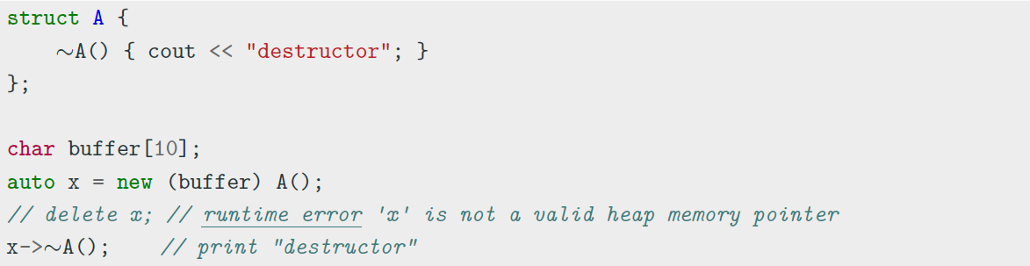
Non-Allocating Placement and Objects ⋆ ⇝
Placement allocation of non-trivial objects requires to explicitly call the object destructor as the runtime is not able to detect when the object is out-of-scope

Slide 20
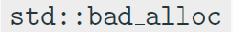
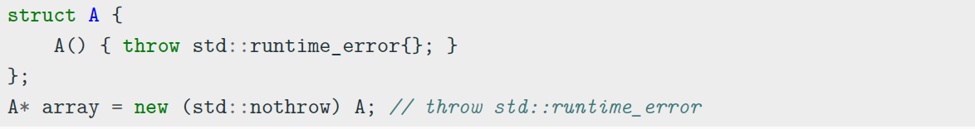
Non-Throwing Allocation
The new operator allows a non-throwing allocation by passing the
std::nothrow
object. It returns a pointer instead of throwing
exception if
NULL
the memory allocation fails
note: new can return pointer even if the allocated size is 0
NULL
std::nothrow
doesn’t mean that the allocated object(s) cannot throw an exception
itself

Slide 21
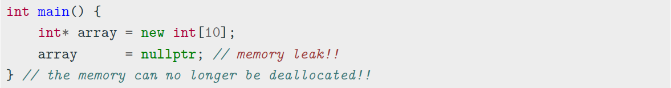
Memory Leak
A memory leak is a dynamically allocated entity in the heap memory that is no longer used by the program, but still maintained over all its execution
Problems:
Illegal memory accesses: segmentation fault/wrong results
Undefined values at their propagation: segmentation fault/wrong results
Additional memory consumption (potential segmentation fault)
Note: the memory leaks are especially difficult to detect in complex code and when objects are widely used

Slide 22
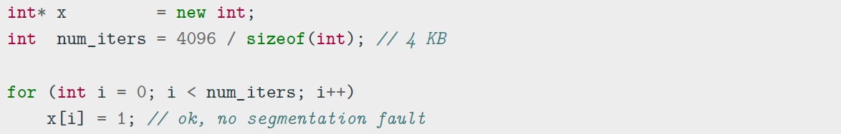
Dynamic Memory Allocation and OS
A program does not directly allocate memory itself but it asks for a chuck of memory to the OS. The OS provides the memory at the granularity of memory pages (virtual memory), e.g. 4KB on Linux
Implication: out-of-bound accesses do not always lead to segmentation fault (lucky case). The worst case is an execution with undefined behavior

Slide 23
sizeof Operator

Slide 24
sizeof operator
sizeof
The sizeof is a compile-time operator that determines the size, in bytes, of a variable or data type
returns a value of type
•
sizeof
size t
sizeof(anything)
never returns 0 (*except for arrays of size 0)
•
sizeof(char)
always returns 1
When applied to structures, it also takes into account the internal padding
When applied to a reference, the result is the size of the referenced type
•
sizeof(incomplete type)
produces compile error, e.g.
void
•
sizeof(bitfield member)
produces compile error
* gcc allows array of size 0 (not allowed by the C++ standard)

Slide 25
sizeof - Pointer
sizeof(int); // 4 bytes
sizeof(int*) // 8 bytes on a 64-bit OS sizeof(void*) // 8 bytes on a 64-bit OS sizeof(size_t) // 8 bytes on a 64-bit OS
int f(int[] array) { // dangerous!!
cout << sizeof(array);
}
int array1[10];
int* array2 = new int[10];
cout << sizeof(array1); // sizeof(int) * 10 = 40 bytes cout << sizeof(array2); // sizeof(int*) = 8 bytes f(array1); // 8 bytes (64-bit OS)

Slide 26
sizeof - struct
struct A {
int x; // 4-byte alignment
char y; // offset 4
};
sizeof(A); // 8 bytes: 4 + 1 (+ 3 padding), must be aligned to its largest member
struct B {
int x; // offset 0 -> 4-byte alignment char y; // offset 4 -> 1-byte alignment short z; // offset 6 -> 2-byte alignment
};
sizeof(B); // 8 bytes : 4 + 1 (+ 1 padding) + 2
struct C {
short z; // offset 0 -> 2-byte alignment int x; // offset 4 -> 4-byte alignment char y; // offset 8 -> 1-byte alignment
};
sizeof(C); // 12 bytes : 2 (+ 2 padding) + 4 + 1 + (+ 3 padding)
Notes:
以四字节为单位分配内存，如果已经分配的空间不足以存储后续的数据，则需要填充已分配空间再分配新空间

Slide 27
sizeof - Reference and Array
char a; char& b = a; sizeof(&a); sizeof(b);
// 8 bytes in a 64-bit OS (pointer)
// 1 byte, equal to sizeof(char)
// NOTE: a reference is not a pointer
//--------------------------------------------------------------
// SPECIAL CASES
struct A {};
sizeof(A); // 1 : sizeof never return 0
A array1[10];
sizeof(array1); // 1 : array of empty structures
int array2[0]; // only gcc
sizeof(array2); // 0 : special case

Slide 28
Streams

Slide 29
Streams
- What are streams?
- Output streams
- Input streams
- String streams!

Slide 30
Definition
stream: an abstraction for input/output. Streams convert between data and the string representation
of data.

Slide 31
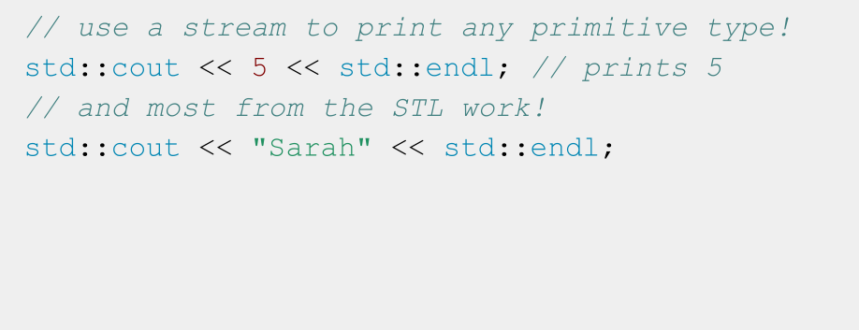
A stream you’ve used: cout

Slide 32
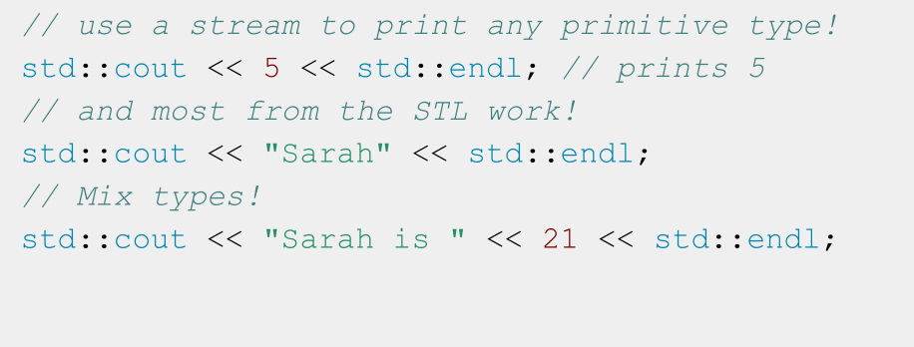
A stream you’ve used: cout

Slide 33
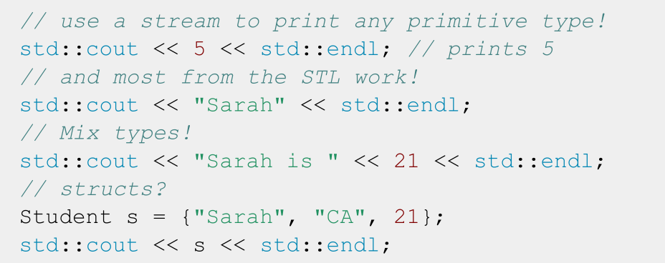
A stream you’ve used: cout

Slide 34
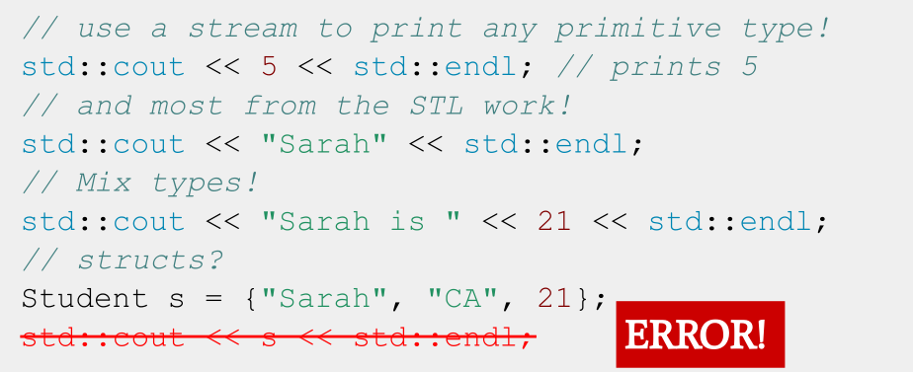
A stream you’ve used: cout

Slide 35
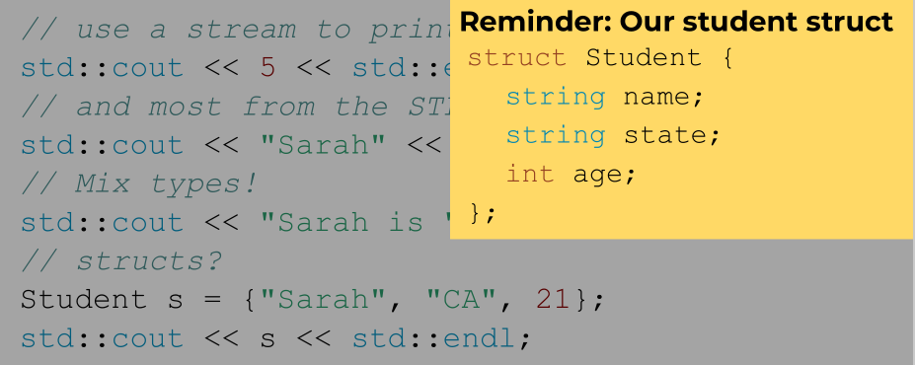
A stream you’ve used: cout

Slide 36
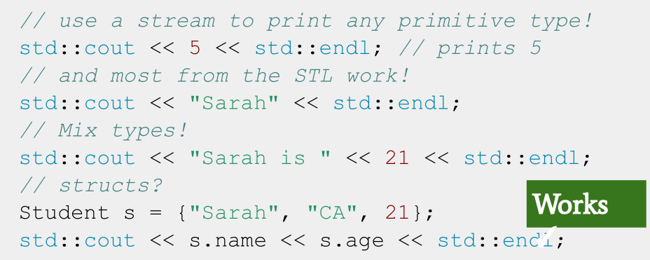
A stream you’ve used: cout

Slide 37
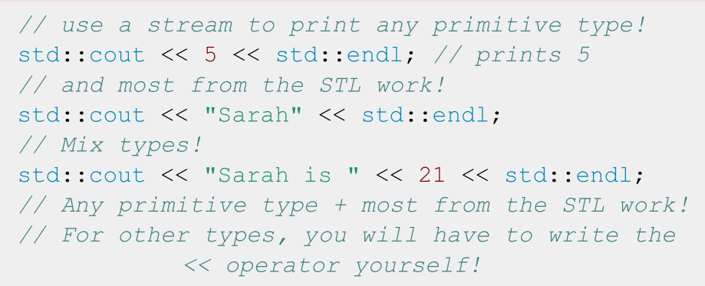
A stream you’ve used: cout
We’ll talk about how to write the << operator for custom types during lecture on Operators!

Slide 38
std::cout is an output
stream. It has type
std::ostream

Slide 39
Two ways to classify streams
By Direction:
By Source or Destination:
● Input streams: Used for
reading data (ex. ‘std::istream’,
‘std::cin’)
● Output streams: Used for
writing data (ex. ‘std::ostream’, ‘std::cout’)
● Input/Output streams: Used
for both reading and writing data (ex. ‘std::iostream’,
‘std::stringstream’)
● Console streams: Read/write to
console (ex. ‘std::cout’, ‘std::cin’)
● File streams: Read/write to files
(ex. ‘std::fstream’, ‘std::ifstream’,
‘std::ofstream’)
● String streams: Read/write to
strings (ex. ‘std::stringstream’,
‘std::istringstream’,
‘std::ostringstream’)

Slide 40
Streams
- What are streams?
- Output streams
- Input streams
- String streams!

Slide 41
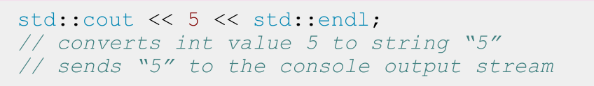
Output Streams
- Have type std::ostream
- Can only send data to the stream
- Interact with the stream using the << operator
- Convert any type into string and send it to the
stream
- std::cout is the output stream that goes to the console

Slide 42
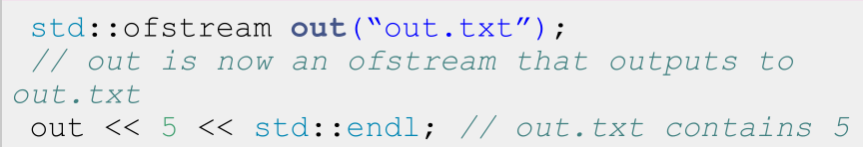
Output File Streams
- Have type std::ofstream
- Only send data using the << operator
- Convert data of any type into a string and send it to the file stream
- Must initialize your own ofstream object linked to your file

Slide 43
std::cout is a global constant object that you get from
#include <iostream>
To use any other output stream,
you must first initialize it!

Slide 44
Streams
- What are streams?
- Output streams
- Input streams
- String streams!

Slide 45
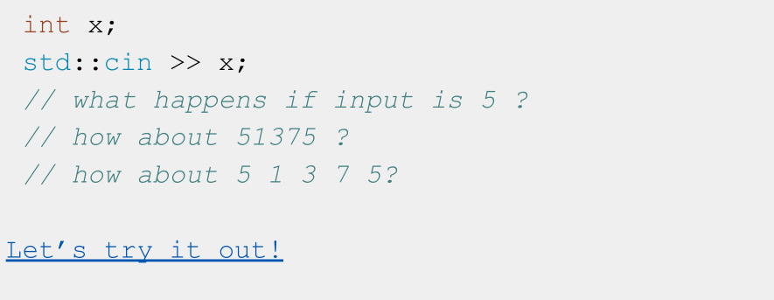
What does this code do?

Slide 46
A note about nomenclature
● “>>” is the stream extraction operator or simply extraction operator
○ Used to extract data from a stream and place it into a variable
● “<<” is the stream insertion operator or insertion operator
○ Used to insert data into a stream usually to output the data to a file, console, or string

Slide 47
std::cin is an input
stream. It has type
std::istream

Slide 48
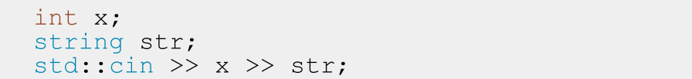
Input Streams
- Have type std::istream
- Can only receive strings using the >> operator
- Receive a string from the stream and convert it to data
- std::cin is the input stream that gets input from the console

Slide 49
Nitty Gritty Details: std::cin
- First call to std::cin >> creates a command line prompt that allows the user to type until they hit enter
- Each >> ONLY reads until the next whitespace
- Whitespace = tab, space, newline
- Everything after the first whitespace gets saved and used the next time std::cin >> is called
- The place its saved is called a buffer!
- If there is nothing waiting in the buffer, std::cin >> creates a new command line prompt
- Whitespace is eaten; it won’t show up in output

Slide 50
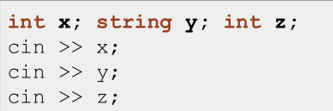
Think of a std::istream as a sequence of characters
4 | 2 |  | a | b |  | 4 | \n
position

Slide 51
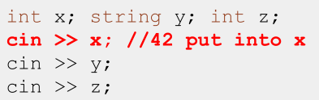
Think of a std::istream as a sequence of characters
4 | 2 |  | a | b |  | 4 | \n
position

Slide 52
Think of a std::istream as a sequence of characters
4 | 2 |  | a | b |  | 4 | \n
position

Slide 53
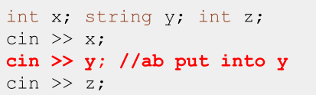
Think of a std::istream as a sequence of characters
4 | 2 |  | a | b |  | 4 | \n
position

Slide 54
Think of a std::istream as a sequence of characters
4 | 2 |  | a | b |  | 4 | \n
position

Slide 55
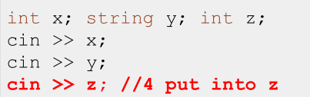
Think of a std::istream as a sequence of characters
4 | 2 |  | a | b |  | 4 | \n
position

Slide 56
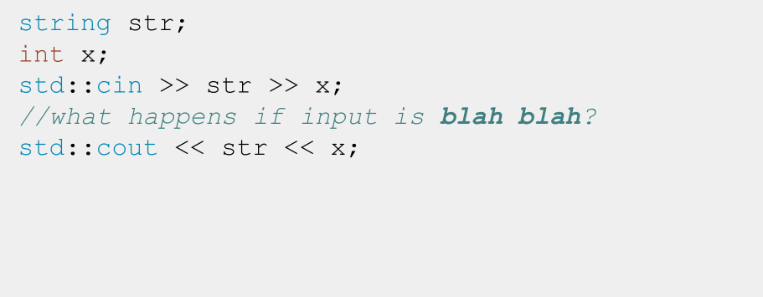
Input Streams: When things go wrong

Slide 57
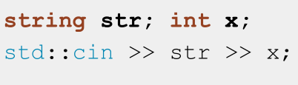
Think of a std::istream as a sequence of characters
b | l | a | h |  | b | l | a | h | \n
position

Slide 58
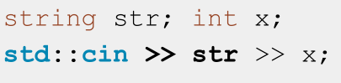
Think of a std::istream as a sequence of characters
b | l | a | h |  | b | l | a | h | \n
position

Slide 59
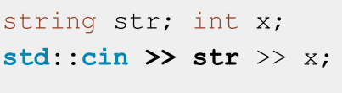
Think of a std::istream as a sequence of characters
b | l | a | h |  | b | l | a | h | \n
position

Slide 60
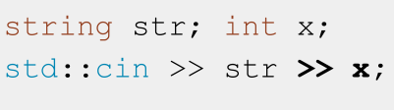
Think of a std::istream as a sequence of characters
b | l | a | h |  | b | l | a | h | \n
position

Slide 61
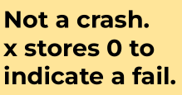
Think of a std::istream as a sequence of characters
FAIL
b | l | a | h |  | b | l | a | h | \n
position

Slide 62
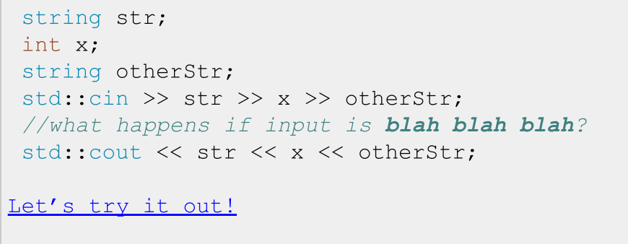
Input Streams: When things go wrong

Slide 63
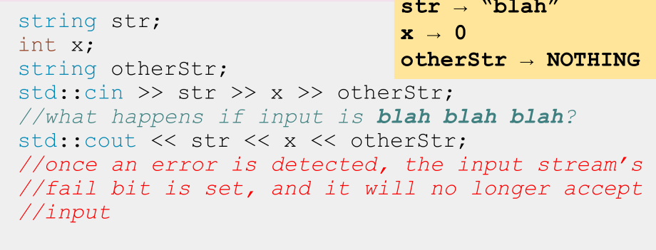
Input Streams: When things go wrong

Slide 64
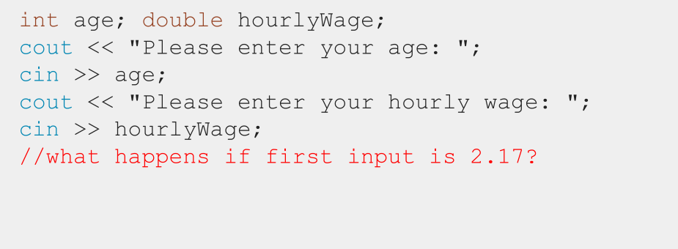
Input Streams: When things go wrong

Slide 65
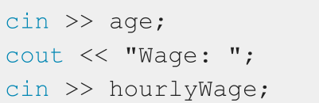
Think of a std::istream as a sequence of characters
2 | . | 1 | 7 | \n
position

Slide 66
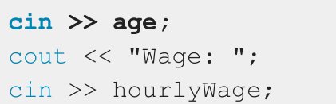
Think of a std::istream as a sequence of characters
2 | . | 1 | 7 | \n
position

Slide 67
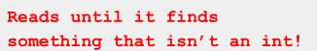
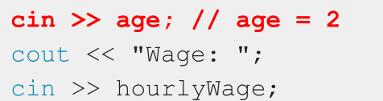
Think of a std::istream as a sequence of characters
2 | . | 1 | 7 | \n
position

Slide 68
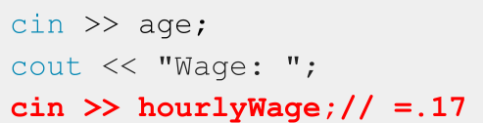
Think of a std::istream as a sequence of characters
2 | . | 1 | 7 | \n
position

Slide 69
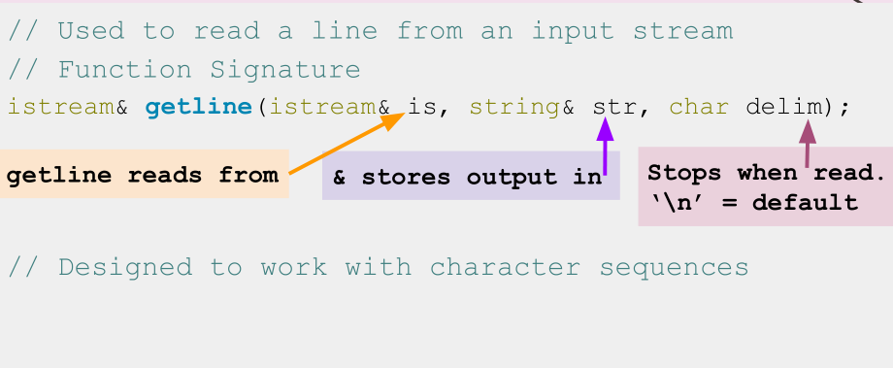
std::getline()

Slide 70
std::getline(istream& is, string& str, char delim)
- How it works:
- Clears contents in str
- Extracts chars from is and stores them in str until:
- End of file reached, sets EOF bit (checked using is.eof())
- Next char in is is delim, extracts but does not store delim
- str out of space, sets FAIL bit (checked using is.fail())
- If no chars extracted for any reason, FAIL bit set

Slide 71
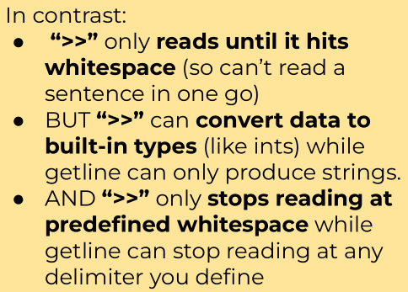
std::getline(istream& is, string& str, char delim)
- How it works:
- Clears contents in str
- Extracts chars from is and stores them in str until:
- End of file reached, sets EOF bit (checked using is.eof())
- Next char in is is delim, extracts but does not store delim
- str out of space, sets FAIL bit (checked using is.fail())
- If no chars extracted for any reason, FAIL bit set

Slide 72
Reading using >> extracts a single “word” or
built-in type
including for strings
To read a whole line, use
std::getline(istream& stream, string& line);

Slide 73
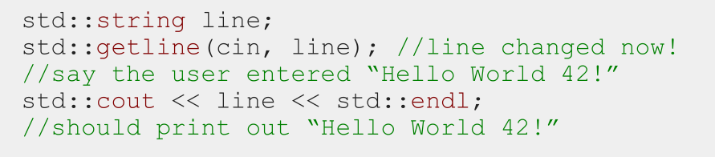
How to use getline
- Notice getline(istream& stream, string&line) takes in both parameters by reference!

Slide 74
IMPORTANT: Don’t mix >> with getline!
- >> reads up to the next whitespace character and does not go past that whitespace character.
- getline reads up to the next delimiter (by default, ‘\n’), and does go past that delimiter.
- TL;DR they don’t play nicely
Notes:
TLDR (or TL;DR) is a common internet acronym for “Too Long; Didn’t Read.”
https://www.howtogeek.com/435266/what-does-tldr-mean-and-how-do-you-use-it/

Slide 75
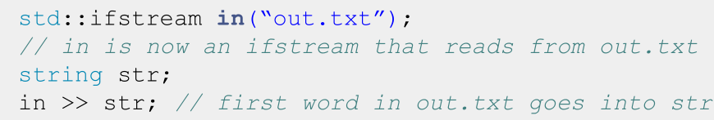
Input File Streams
- Have type std::ifstream
- Only receives strings using the >> operator
- Receives strings from a file and converts it to data of any type
- Must initialize your own ifstream object linked to your file

Slide 76
std::cin is a global constant
object that you get from
#include <iostream>
To use any other input stream, you
must first initialize it!

Slide 77
Streams
- What are streams?
- Output streams
- Input streams
- String streams!

Slide 78
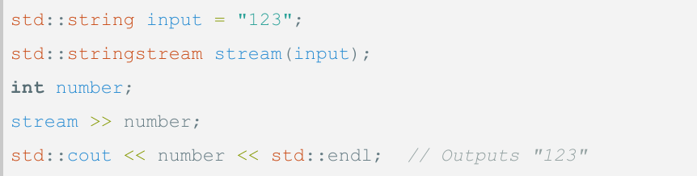
String streams
- What: A stream that can read from or write to
a string object
- Purpose: Allows you to perform input/output
operations on a string as if it were a stream

Slide 79
If you only want to read OR write data:
- Read only: std::istringstream
- Give any data type to the istringstream, it’ll store it as
a string!
- Write only: std::ostringstream
- Make an ostringstream out of a string, read from it word/type by word/type!
- Follows same patterns as the other i/ostreams!

Slide 80
Coding to change the world
Qijun Zhao
qjzhao@scu.edu.cn

